Slide 1



Development of a Low-cost Sensor Chain for Photosynthetically Active Radiation Measurement
Sarah Tallack
Supervisor: Robyn Verrinder

Slide 2
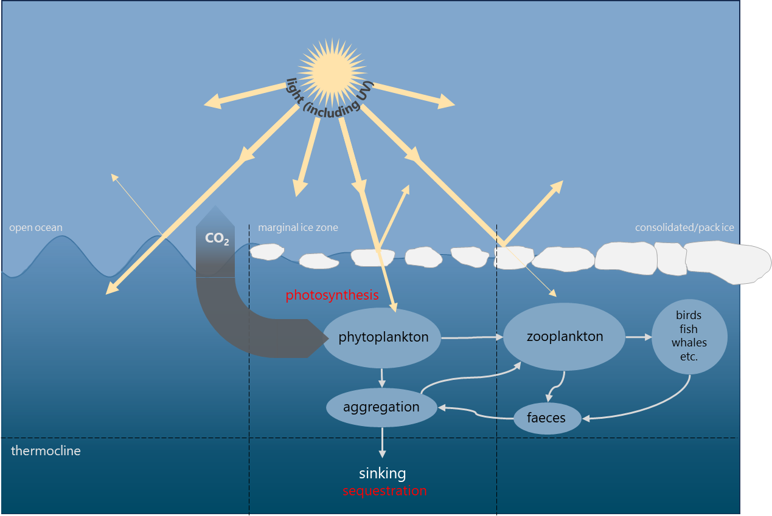
Background & Motivation
The Southern Ocean plays a crucial role in global climate patterns
The Marginal Ice Zone is the interface region between open water and pack ice
Phytoplankton are single celled organisms that form the base of the Southern Ocean food web.
Diagram showing connections between phytoplankton and larger food web, modified from [Deppeler, 2017]

Slide 3
Phytoplankton
Growth affected by
Light availability
Nutrients available
Temperature
Wind strength
Diagram showing connections between phytoplankton and larger food web, modified from [Deppeler, 2017]

Slide 4
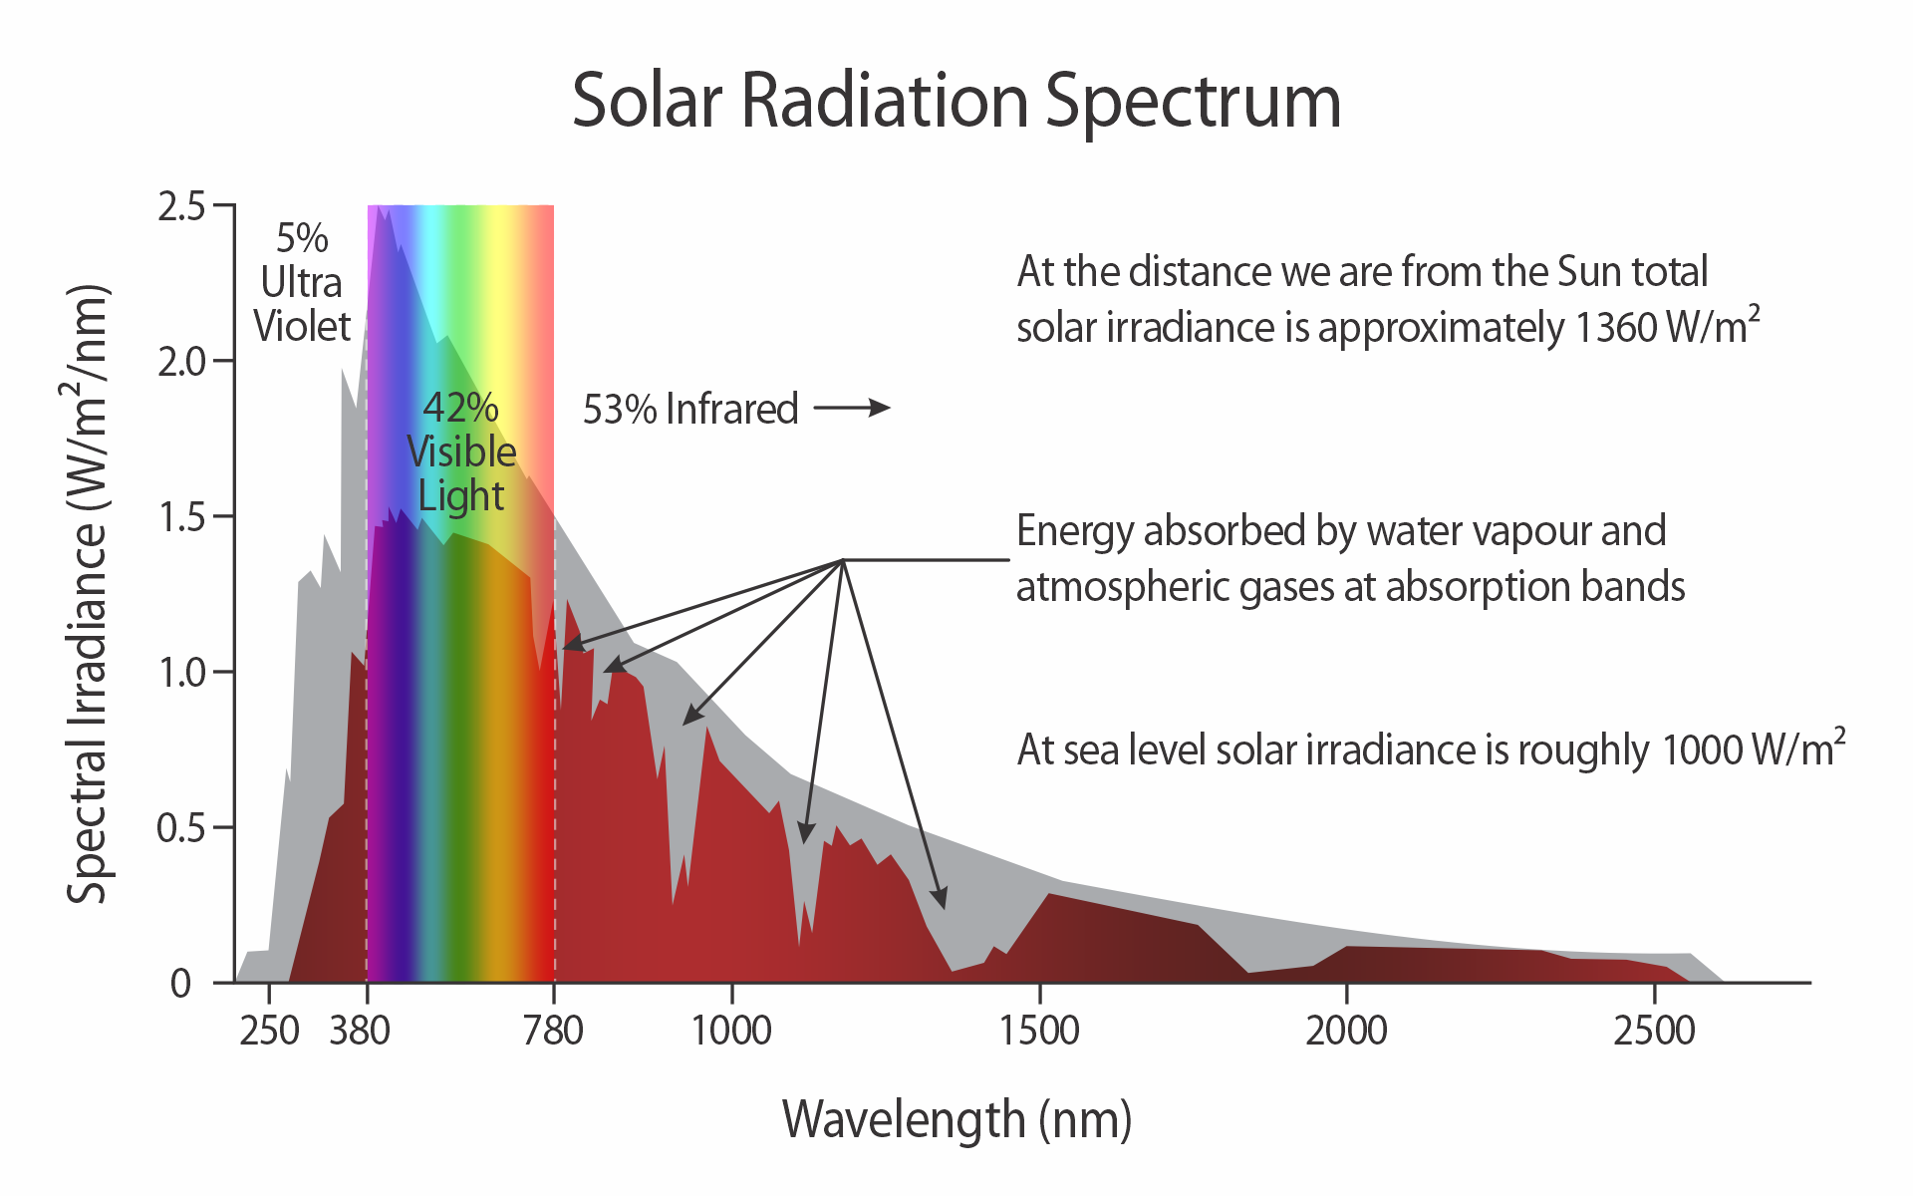
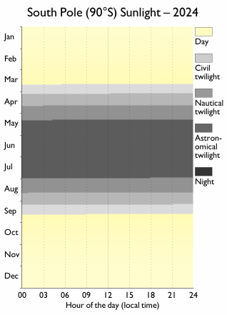
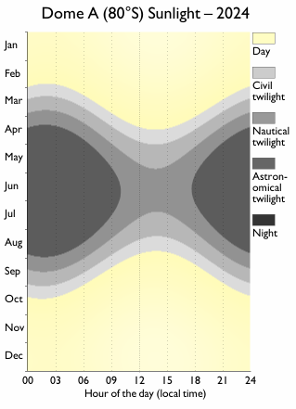
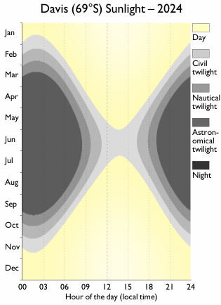
Light in the Antarctic
Figures showing how the length of the day changes throughout the year
Solar Radiation Spectrum

Slide 5
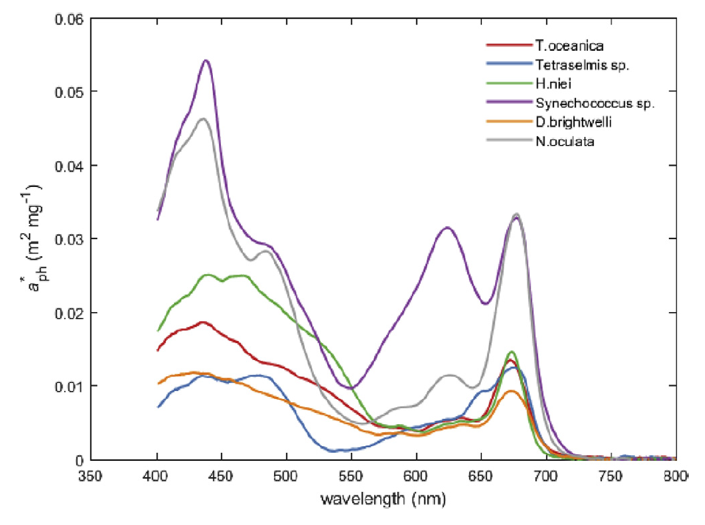
Photosynthetically Active Radiation (PAR)
Spectral range of solar radiation used in the process of photosynthesis
400 nm to 700 nm (Visible spectrum)
Unit of measurement: μmole.m²/s
Chlorophyll-specific phytoplankton absorption spectra, from [Clementson, 2019]

Slide 6
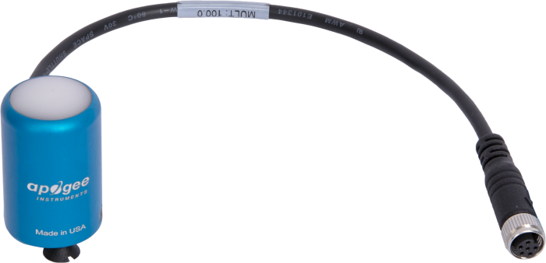
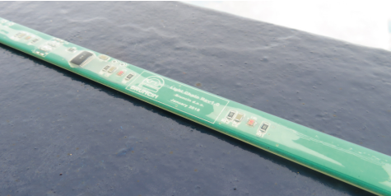
Commercially available PAR sensors
Solutions using off-the-shelf components
High cost per unit
Lower cost per unit
Readily available and pre-calibrated
Components are readily available
High accuracy
More extensive testing and calibration required
Methods for Measuring PAR

Slide 7
Solutions using off-the-shelf components
Analog photoelectric sensors with optical filters
Digital Photoelectric Sensor
Requires careful selection of both photodiodes and filters
Optical filters can be expensive and difficult to find
More involved electronic design
Use standard communication protocols
Most sensors have built-in ADCs
Filters and photodiodes already selected.

Slide 8
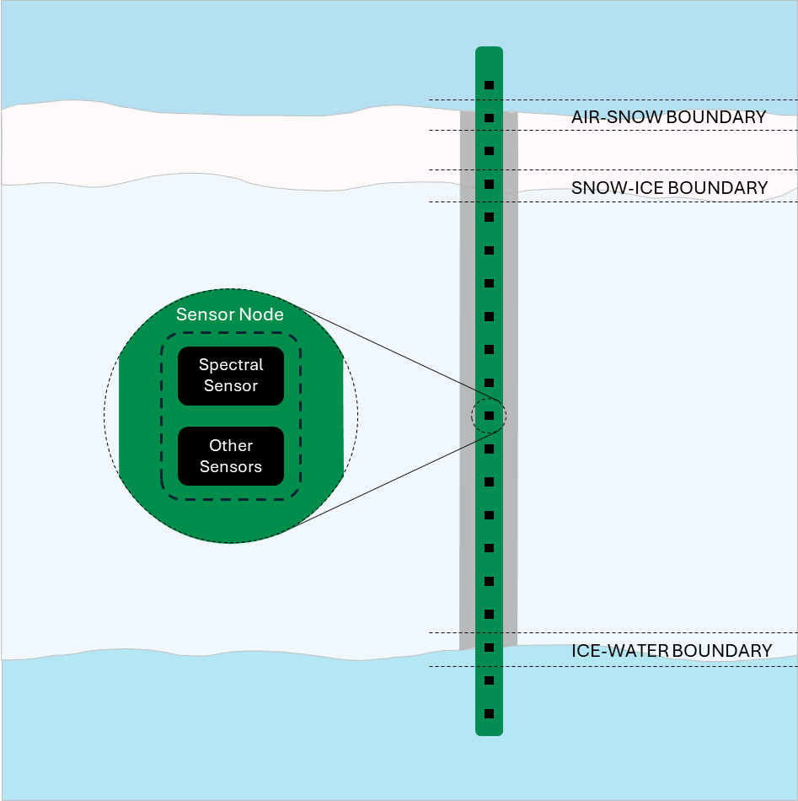
Sensor chain design
Develop a chain of optical sensors which can be used to measure the radiative transfer through sea ice
Should be attachable to the UCT ice-tethered buoy.
Focus on power efficiency
Include additional sensors for expanded functionality

Slide 9
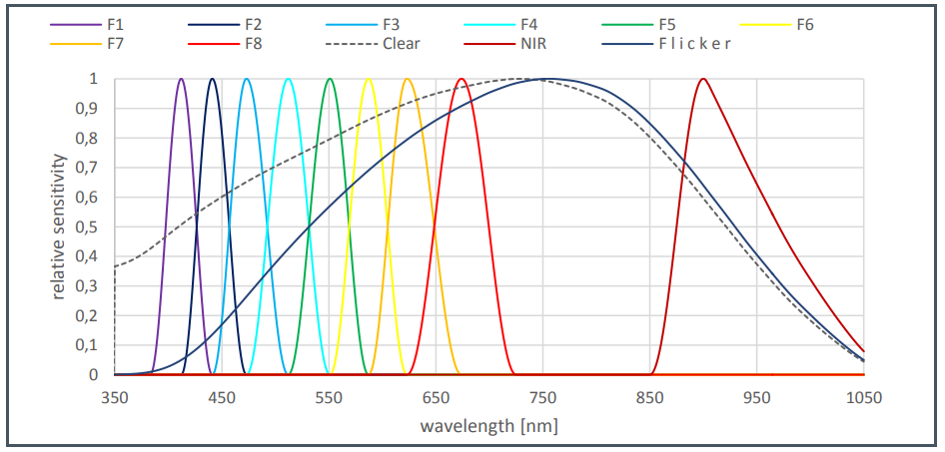
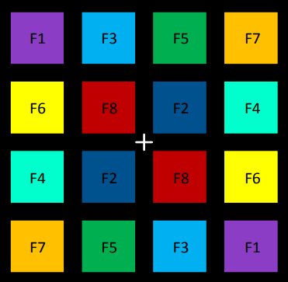
Multi-channel Spectral Sensors
Consists of photodiode pairs with carefully selected optical bandwidth filters.

Slide 10
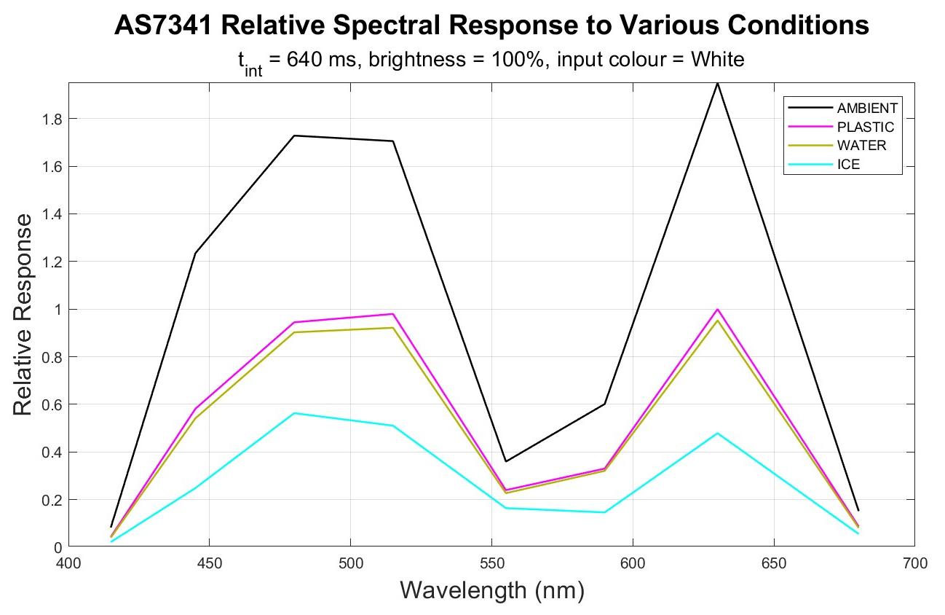
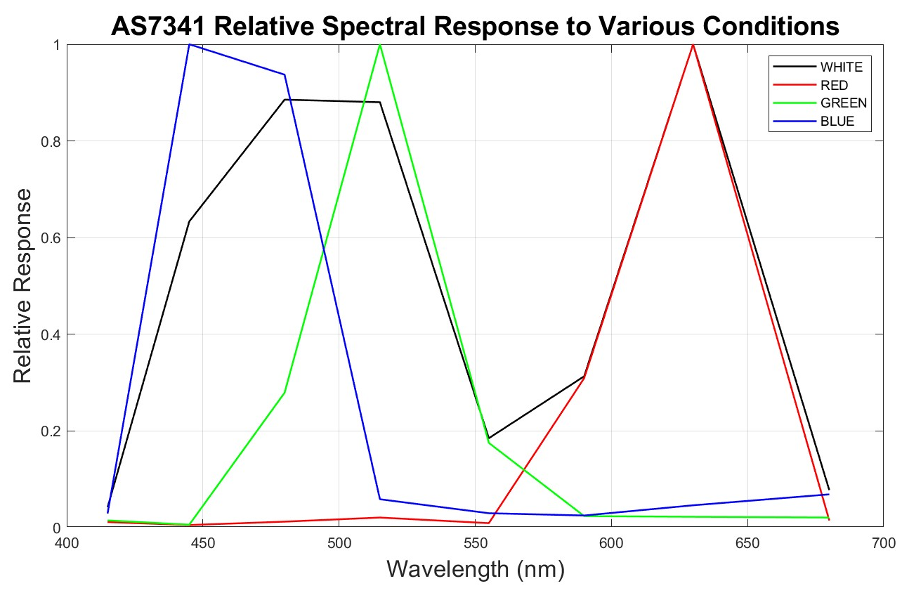
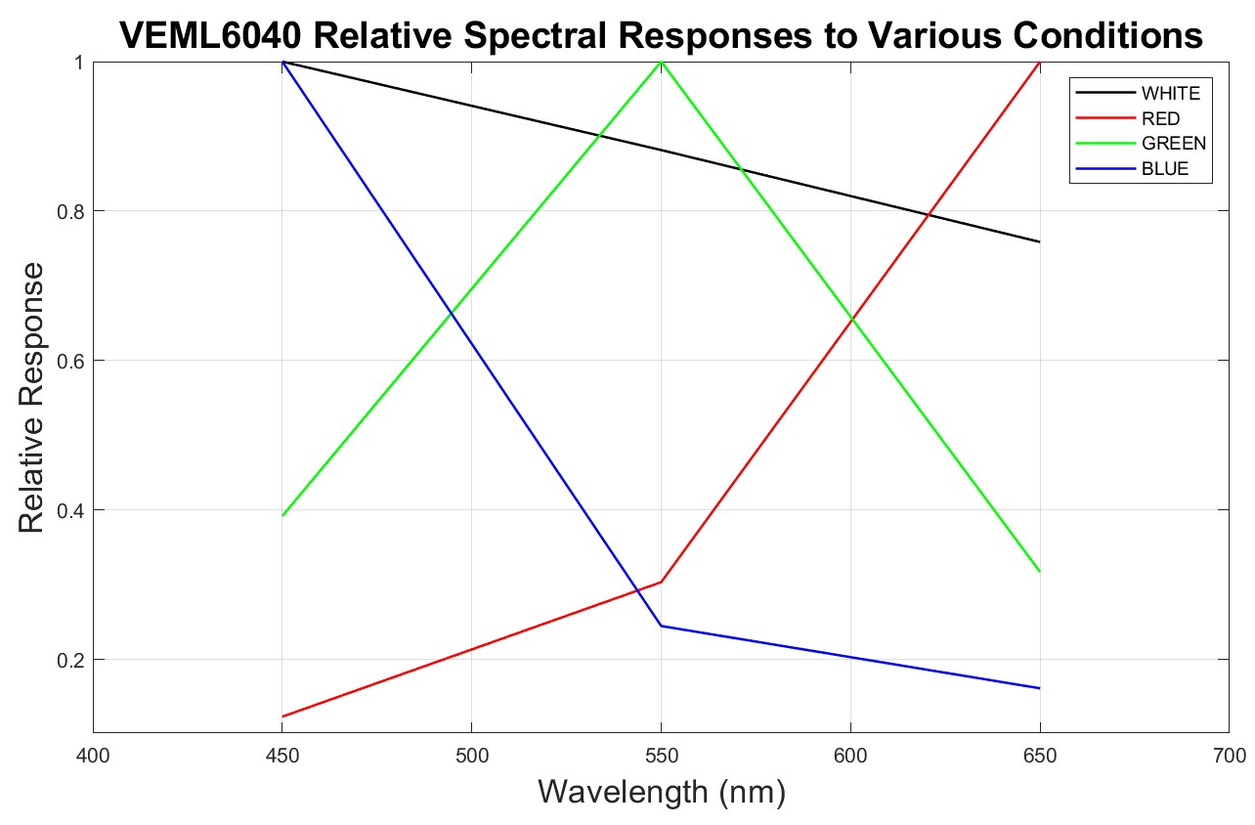
Previous Work
AS7341 Relative Spectral Response to Various Conditions, with White LED
Red LED
Green LED
Blue LED
Multi-channel spectral sensor
RGBW Sensor
Example of sensor output in response to a white light input.

Slide 11
Current Work
Have ordered and received 2 boards
Will be ordering another 2 boards soon
Developing code to interface with the two sensors and I2C multiplexer.

Slide 12
Future work
Sensor characterisation
Environmental testing
Sensor chain development
Access an actual PAR sensor to use for calibration purposes

Slide 13
Questions?

Slide 14
References
Stacy L. Deppeler and Andrew T. Davidson. Southern ocean phytoplankton in a changing climate. Frontiers in Marine Science, 4, February 2017. ISSN 2296-7745. doi: 10.3389/fmars.2017.00040. URL: https://www.frontiersin.org/articles/10.3389/fmars.2017.00040. doi: 10.3389/fmars.2017.00040.

